Slide 1


Smart Agriculture system based on IoT
-Submitted by Pasupula Rajini

Slide 2

Overview:
Smart Agriculture System based on IoT can monitor soil moisture and climatic conditions to grow and yield a good crop.
The farmer can also get the real-time weather forecasting data by IoT Simulator and external platforms like Open Weather API.
Farmer is provided a app using which he can monitor the temperature, humidity and soil moisture parameters along with weather forecasting details.
Based on all the parameters he can water his crop by controlling the motors using the mobile application.
Even if the farmer is not present near his crop he can water his crop by controlling the motors using the mobile application from anywhere.

Slide 3


Block Diagram:
IBM CLOUD
IBM IoT Platform &
IBM Watson IoT Platform
Web App
MOTOR
ON/OFF
MQTT
HTTP
Alerts
&
Notifications
Open Weather API
Watson IoT Simulator

Slide 4
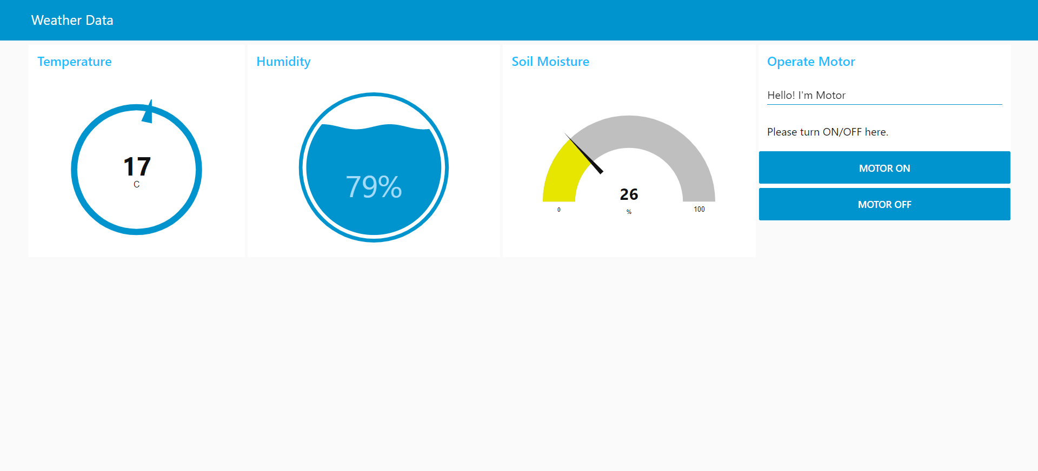
User Interface:

Slide 5


